Slide 1
Common Sense Economics : A Guide to Critical Thinking
Compiled by: Roland Atta-Ampiah Desmond Awadzi
Bruce Baginski Charles Bissette
Adanda Fondon

Slide 2

Comparative Advantage in Trade
This is the ability for an individual, business, or government who specializes in producing a product or delivering a service at a lower opportunity cost then a competitor to create as many of the products or perform as many of the services capable to earn the most revenue for that product or service. The individual, business, or government will then purchase items or services that would be too costly produce themselves (Gwartney, 2019, pg. 15).
Comparative advantages can make everyone in the transaction process better off by ensuring the resources are being used for the maximization of specialized activates to produce the highest revenue.

Slide 3

Wages of an entity (Nation, Region, Local Area) are set based on the productivity of that area.
The inequality of income and differences of poverty between two entities can be found in the production of each entity.
Healthier benefits/wages are felt when the higher-producing entity has focused the resources owned on performing the specialized activates they have a comparable advantage in. (Gwartney, 2019, pg. 93).
Comparative Advantage in Wages

Slide 4

Comparative Advantage in Your Personal Opportunity
Individuals have the ability to improve their income when they specialized their efforts toward the activities they have a comparative advantage in. (Gwartney, 2019, pg. 176).
To receive high earnings, the individual must provide high value activates what the customer is willing pay. We must learn to continually strengthen the individual comparative advantage by cultivating skills, attitudes, and creativity to increase the value of specialized activities and make weakness irrelevant (Gwartney, 2019, pg. 180).

Slide 5

Prices Bring the Choices of Buyers and Sellers into Balance
Price is a major factor that guides the actions of both sellers and buyers.
Whereas there is an inverse relationship between buying power (buyers) and price; there is a positive between the supply components (suppliers) and price (Gwartney, Stroup, Lee, Ferrarini, & Calhoun, 2016).

Slide 6
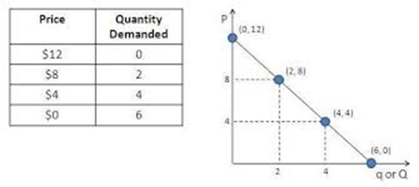
Law of Demand
All things being equal, buyers will buy more at lower prices and less at higher prices, this denotes the law of demand. As a rational human being, lower prices mean more residual income to be used for other alternatives. As depicted is the Fig 1.1 prices move from low to high, quantity demanded slides from high to a low (Pearson, 2019)
Fig 1.1

Slide 7
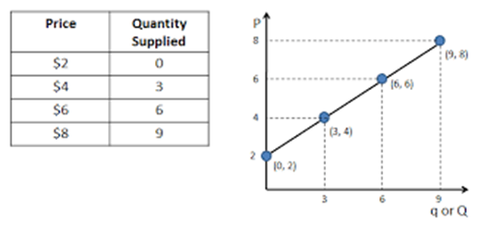
Law of Supply
Suppliers are motivated by higher prices to make more profit, and will tend to supply more at higher than lower prices; this denotes the law of supply. Suppliers will devote more resources when there is a chance to make more returns on investment. As depicted in Fig 1.2, as prices rise from $2 to $8, quantity supplied rise from 0 to 9, indicating a positive relationship between (Pearson, 2019).
Fig 1.2

Slide 8
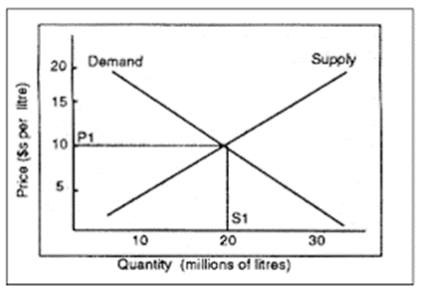
Equilibrium Dilemma
If both the buyer and supplier live on these extremes, how can both be satisfied?
The answer to this, is termed Equilibrium; the point at which both the buyer and seller agree to a specific quantity and price that satisfies their individual objectives. Per the Fig 1.3, at P1 and S1 both the supply and demand curves intersect (Price $10, Quantity 20 units), at this point there isn`t any surplus or shortage in the market and both parties are satisfied
Fig 1.3
Notes:
Shortages will exist when prices fall below $10, at $5 customers will purchase 25M litres whereas suppliers will make available 15M litres, due to the higher level of demand, prices will be forced to rise until the equilibrium of $10 is reached. Alternatively, a surplus situation arises when supply is more than demand; should prices rise to $15; suppliers will be enticed to supply 25M litres whereas buyers will buy 15M litres. Higher inventory cost and overhead cost will force suppliers to cut their prices to $10 to balance the market forces.

Slide 9
What is Scarcity?
The basic economic problem, the gap between limited-that is scarce-resources and theoretically limitless wants (Investopedia, 2019).

Slide 10
Scarcity
The first lesson in economics is scarcity: there is never enough of anything to full satisfy all those who want it. The first lesson of politics is to disregard the first lesson of economics
- Thomas Sowell, Professor of Economics, Stanford University
(Sowell, 2014)

Slide 11
Shortage
A condition in which the amount of a good offered for sale by producers is less than the amount demanded by buyers because government has imposed a below-equilibrium price (Gwartney,Stroup,Lee,Ferrarini & Calhoun, 2016).

Slide 12
Reasons of shortage
Increase in demand
Decrease in supply
Government intervention

Slide 13
Conclusion
This Presentation deals in explaining three important concepts which being the
1) Comparative Analysis on Economic Terms
2) Concept of supply and Demand
3) Concept of Scarcity and Surplus , Shortage
Hence, this presentation analyzes the common concepts and general analysis on account of the economic terms.

Slide 14
References
Gwartney, J. D. (2016). Common sense economics: what everyone should know about wealth and prosperity. Macmillan.
Pearson, D. (2019). Income Redistribution, Economic Freedom, and State Growth as considerations for Location Strategy.
Sowell, T. (2014). Basic economics. Hachette UK.

